Slide 1

The Battle of Neighborhoods
Find the best spot for a restaunt in Paris
April, 2020

Slide 2
CONTENT
01
03
04
Introduction
Data Analysis
02
Score System and Conclusions
DataFrame

Slide 3
01
INTRODUCTION
In a world where competitiveness is at his highest peak, a simple, modest pastry is trying to fit into Paris. As anyone else, this restaurant wants to be very successful. In order to accomplish this dream they know that the very first step to make it is to decide a location to sell the deliciousness they know they can produce.
After some brainstorning they realized they had to come up with certain factors that will impact their decision to choose a location. After a while they come up with security, competition and population. In a city as big as Paris, they wanted to go to a safe location where crime could not affect the costs that they might have. Also, competition must be low so that they could stand out among other restaurants. Finally, without enough clients they wouldn't make it so it's important that they settle in an area with a lot of populations.
So, now that the factors are decided, it's important to analyze data to make the best decision possible.

Slide 4




01
INTRODUCTION
SECURITY
ENVIRONMENT
POPULATION
The place should be safe.
The place should have not much competition.
Should be high populated.

Slide 5




02
To report the most popular places in Paris
To undertand its arrondissements and its population
DATA
FRAME
FourSquare API
Paris Arrondissements List
To access to criminality reports
As a base of the course
Paris recorded Crime
IBM Course

Slide 6

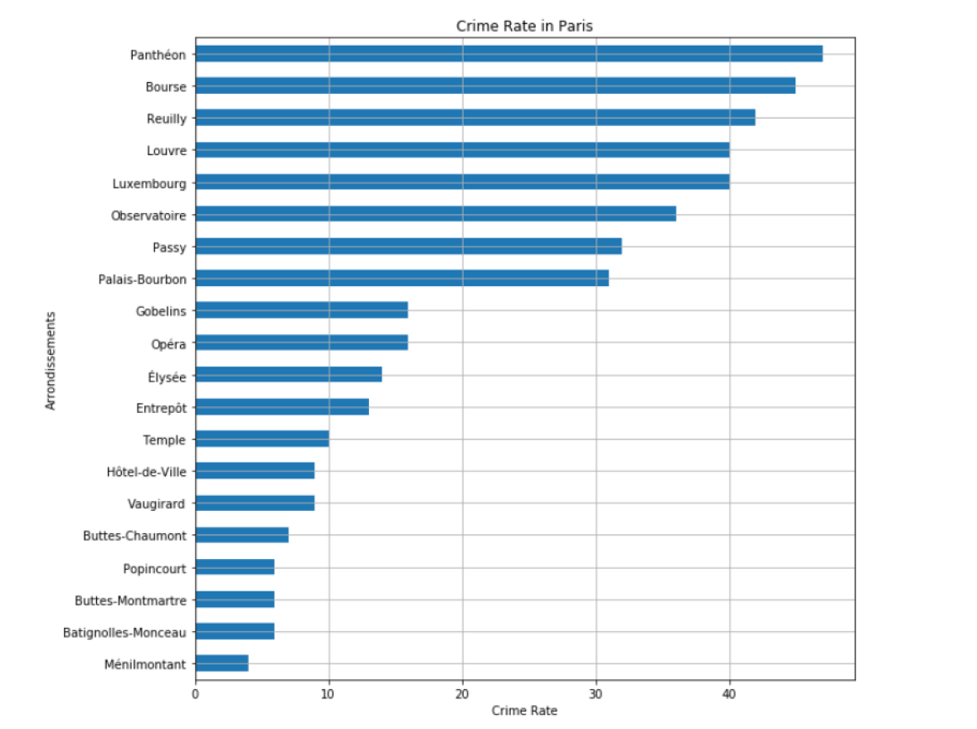
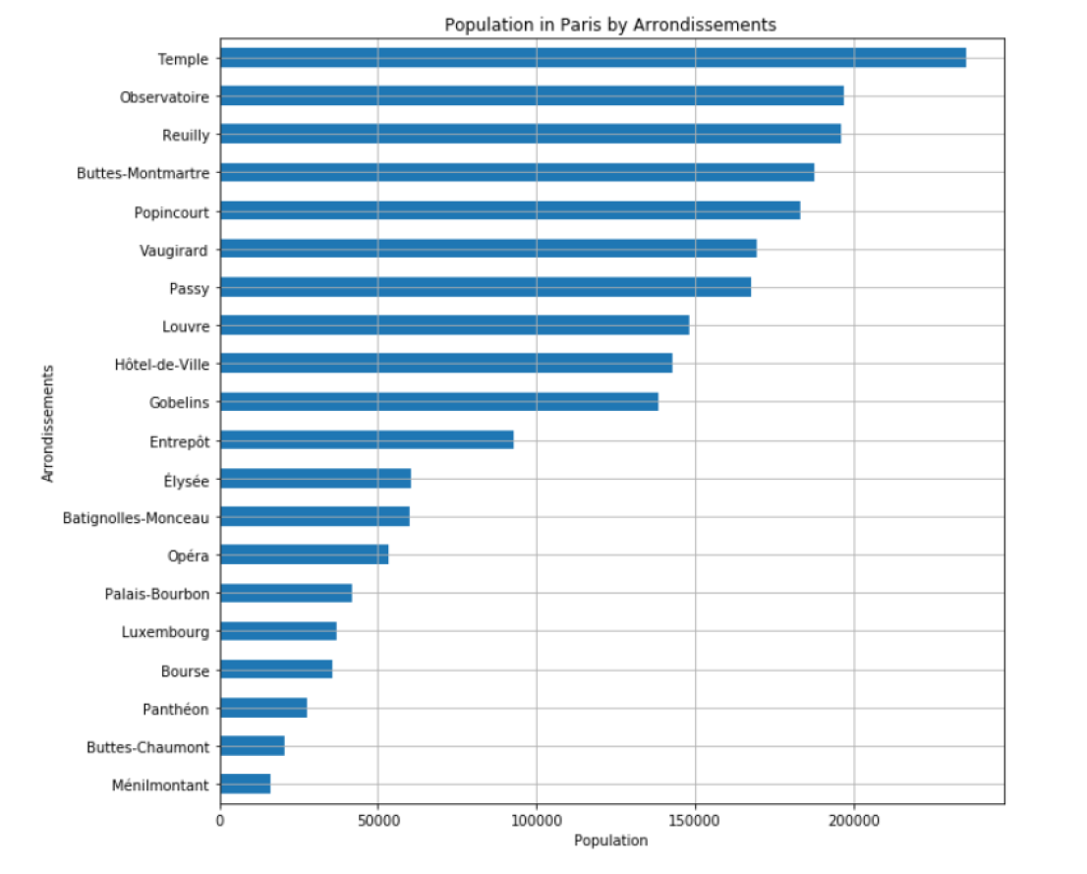
03
DATA ANALYSIS
Exploratory Data Analysis
Data visualization
They started with some EDA (Explanatory Data Analysis) and realized the most safe places to set up a business as well as the most populated places where there was more potential for a higher number of clients.

Slide 7

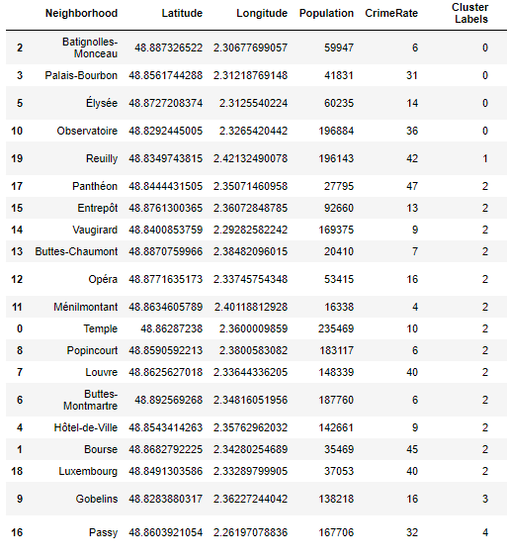
03
METHODOLOGY
Cluster Analysis
After sorting the data in the EDA, where they got information in safety and client potencial, the last factor analyzed is missing: venues competition. Their objective was to find anarrondissement where there was not a lot of restaurants, so that they could grow and build a community around their restaurant. In order to do it, it was utilized a data from Foursquare to form a dataframe to classify each arrondissement in terms of most common venues. That way we could cluster the arrondissements considering their similarities and therefore choose the best cluster to set up a restaurant.

Slide 8
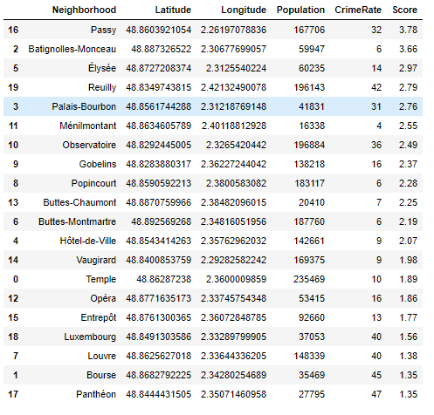
04
SCORE SYSTEM
After the data analysis, for a more quantitive based decision, they ended up creating a score system that you can see in the final database.

Slide 9
04
SCORE SYSTEM
Passy was the final decision!

